Slide 1

SEA SAFE
A fisher asks, in their own language, if it is safe to take a small boat out. Sea Safe answers SAFE, CAUTION or UNSAFE, with the reasons.
SAFE
CAUTION
UNSAFE
Team Forge
Vishal Padmanabhan · Nikhil Ritesh Pondicherry
BITS Pilani, Dubai Campus
NOVA 2026 Grand Finale · Track D: AI & Autonomous Systems
Notes:
Sea Safe helps small-scale fishers decide whether to take a small open boat out. They ask by voice, text or a tap on the map, in English, Kannada or Arabic. The answer is one of three verdicts, always shown as colour plus shape plus word, and always with the reasons.

Slide 2
Before dawn, a fisher must judge the sea alone
02 · PROBLEM STATEMENT
Who it is for
Small-scale fishers in open boats under 10 m, many new to apps
ILLUSTRATIVE SCENARIO
04:30 at Malpe harbour. A small open boat. Six hours at sea.
The barrier
Marine forecasts are technical, mostly in English, built for chart readers
Why it matters
A wrong call risks lives. An over-cautious one costs a day's income
Go, wait, or stay?
The gap
One hour's forecast is not a verdict for a whole trip at sea
Forecast services already exist (IMD, INCOIS, NCM). A plain answer about one trip, in the fisher's language, does not.
Notes:
The scenario is illustrative, not from an interview. Official forecasts exist, but they are technical and mostly in English. A fisher needs an answer about one specific trip, in their own language, that covers the whole time at sea. We do not quote accident statistics because we have not verified any.

Slide 3
One trip, one clear verdict, with the reasons
03 · PROPOSED SOLUTION & INNOVATION
1
2
3
4
Ask
Understand
Check
Answer
Speak, type or tap the map, in English, Kannada or Arabic.
The model reads place, time and trip length. Code asks for what is missing.
Every hour of the trip is tested against published limits. The worst hour decides.
Colour, shape and word, then the reasons and safer times. Read aloud.
WHAT IS NEW
The model never decides
Cautious by design
Every limit has a source
It only reads the question. Fixed code computes every verdict and number.
Missing, stale or near-the-line data gives CAUTION, never SAFE.
FAO/ILO/IMO, WMO and IMD documents, shown inside the app.
KEY FEATURES
Hands-free voice
48-hour time slider
Safer departure times
Trip watch alerts
Share a trip check
Notes:
Four steps. The language model is used only to understand the question and call one tool. The verdict comes from fixed rules: every hourly record from departure to return is checked, and the worst hour decides. If data is missing, older than 6 hours, or within 10% of a caution line, the answer is CAUTION. Thresholds come from the FAO/ILO/IMO safety recommendations for small fishing vessels, WMO manuals and IMD fishermen-warning criteria. Wave limits: CAUTION from 1.25 m, UNSAFE from 2.0 m.

Slide 4







Voice, chat and map all call the same service
04 · TECHNICAL ARCHITECTURE & IMPLEMENTATION
ASK
UNDERSTAND
SHARED SERVICE · FASTAPI
TELL
Voice
ElevenLabs Scribe v3
AI model
Weather data
Fixed rules
Answer
Chat
Turns the question into a tool call. Never decides.
Open-Meteo Marine and Forecast APIs
Every hour of the trip against published limits. The worst hour decides.
Reviewed templates in English, Kannada and Arabic, read aloud
A typed question
Map taps skip the model
Map
30-minute file cache
ElevenLabs v4 Turbo
Tap a harbour
Python · FastAPI
MapLibre GL
Gemini 3.5 Flash-Lite
Groq gpt-oss-120b
ElevenLabs voice
Web Push · email
pytest
Notes:
Three ways in, one service. Voice is transcribed by ElevenLabs Scribe v3 and then follows the chat path. The language model (Gemini 3.5 Flash-Lite first; Groq gpt-oss-120b is also asked if Gemini has not answered in 1.5 s, and takes over if Gemini fails) only turns the question into a tool call, and every call is checked against its schema before it runs. Map taps skip the model entirely. The shared FastAPI service (app/service.py, also open as POST /api/assess and /api/safest) fetches Open-Meteo Marine and Forecast data, cached in JSON files for 30 minutes. Fixed rules in app/assessment.py, with limits in config/thresholds.yaml, produce the verdict: the worst hour of the trip decides, and missing or stale data gives CAUTION. Reviewed templates produce the words, which ElevenLabs v4 Turbo reads aloud. The map is MapLibre GL on free OpenFreeMap tiles. Trip watch: the server re-checks a watched trip every 15 minutes with the same rules until departure, and only a change of verdict is sent, by Web Push notification and, if the fisher gives an address, by email through Gmail. There is no database, and we trained no model.

Slide 5
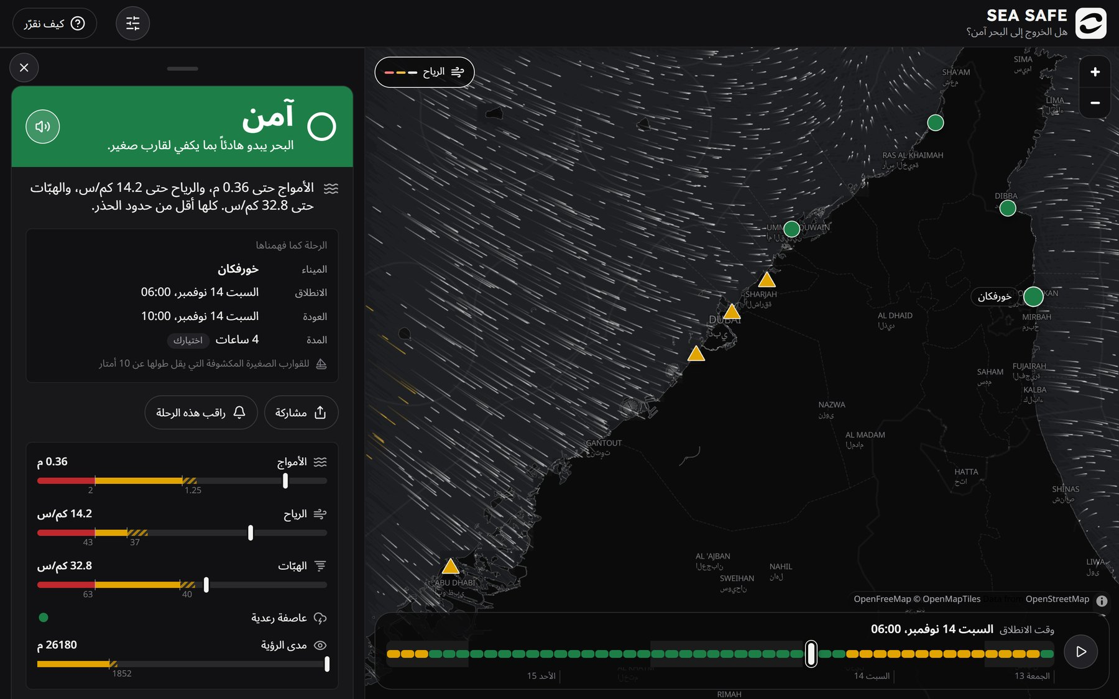
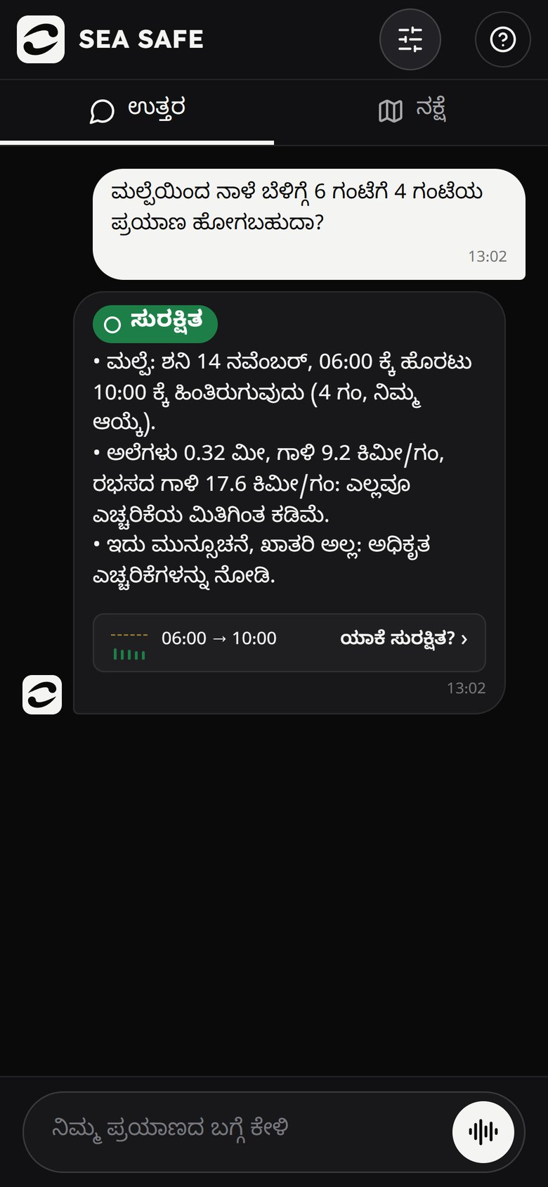
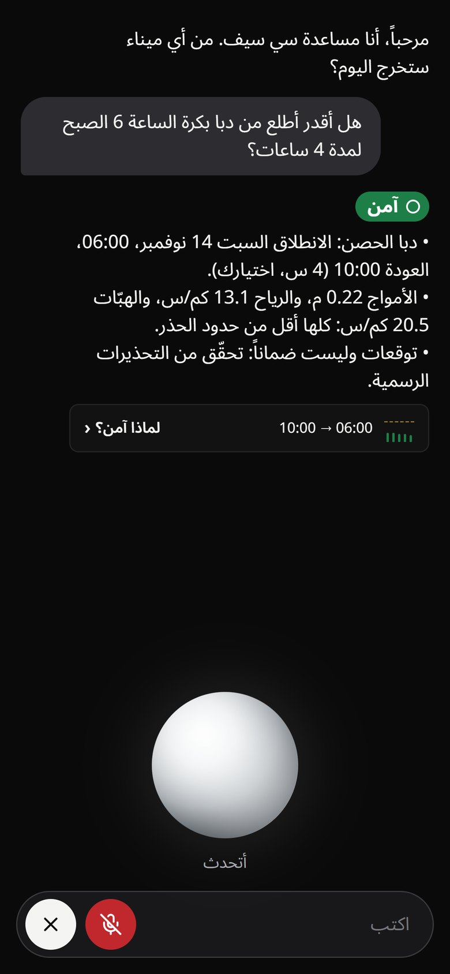
What is built and running today
05 · PROTOTYPE & DEMONSTRATION
Laptop, in Arabic: the full answer, with each limit as a gauge, Share and Watch this trip
Phone chat, in Kannada
Phone voice mode, in Arabic
Notes:
Real screenshots of the running app. Left, on a laptop in Arabic: the answer sheet for Khor Fakkan, SAFE, with each limit drawn as a gauge, the trip as understood, and the Share and Watch this trip buttons; the map shows mixed verdicts along the coast and the 48-hour slider coloured by verdict. Middle, on a phone in Kannada: a typed question about Malpe and the SAFE answer with its reasons. Right, on a phone in Arabic: voice mode, which greets the fisher, answers aloud and stops when you talk over it. Also built: safer departure times, the last answer kept when offline, and light and dark mode. Suggested live demo: ask about one trip in Kannada or Arabic, change the trip length with a follow-up, talk over the voice to show it stops and listens, tap 'Check safer departure times', then start watching the trip with an email address. The page always uses the live forecast, so if the sea is calm on the day every harbour may show SAFE.

Slide 6
Tested rules, measured replies, stated limits
06 · RESULTS, IMPACT & SCALABILITY
693
68 / 68
0.9 s
3 · 2 · 16
automated tests, run offline with no network
test turns understood by Gemini in three languages (small sample)
median model time per question (Gemini, 68 turns)
languages, coastal regions and harbours live today
Practical impact
Feasibility
Scalability and future
Limits we state plainly
Plain verdicts in three languages. On 2022–25 data: SAFE on 85–99% of Nov–Apr days, UNSAFE on most monsoon days.
Free public data, no paid weather API, no model training. Runs with one command.
A new coast is a harbour list and one translation file. Next: read official warnings, test with fishers.
Warnings are linked, not read yet. One forecast point, not a route. Needs expert and native review.
Notes:
The test count is the number of collected test cases; run pytest before presenting and quote the current pass count. 68 of 68 is from a head-to-head of 5 conversations (34 turns, run twice) in English, Kannada and Arabic on saved weather: Gemini 68 of 68, Groq 66 of 68. It is a sanity check, not a benchmark. 0.9 s is Gemini's median model time per turn in that test; Groq's was 0.52 s, and a full voice turn was about 2.4 s median with Gemini. Calibration: a 05:00 departure on a 6-hour trip, every day from 2022 to 2025; the UAE figure is SAFE on 76 to 96% of days. Be direct about the limits: this is a forecast aid that has not been validated in the field.

Slide 7
The model understands the fisher. Code decides
07 · CONCLUSION & TEAM
Every answer says it is a forecast, not a guarantee, and shows where its numbers came from.
TEAM FORGE · BITS PILANI, DUBAI CAMPUS
Vishal Padmanabhan
[what Vishal built]
Nikhil Ritesh Pondicherry
[what Nikhil built]
LINKS
Questions?
GitHub: github.com/vishl4534-arch/sea-safe
Demo: [video or live link]
Notes:
Close on the design principle: the language model handles language, and fixed, tested code handles safety. Replace the bracketed contributions and demo link, and check the GitHub link opens from a signed-out browser (the repository must be public).

